Slide 1
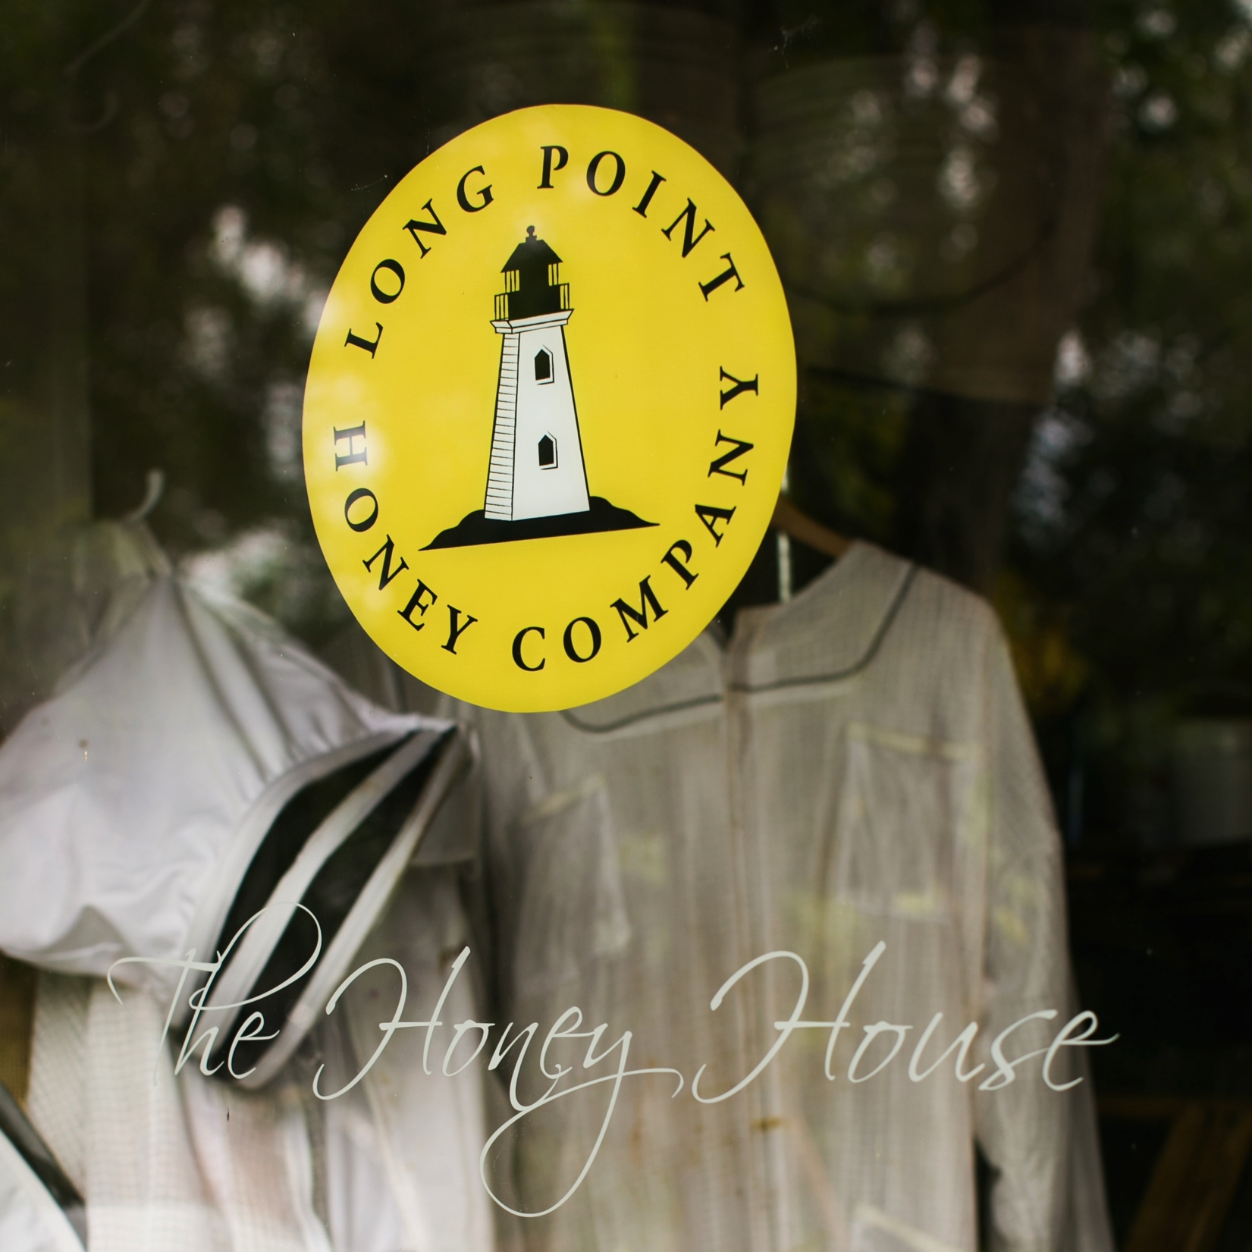
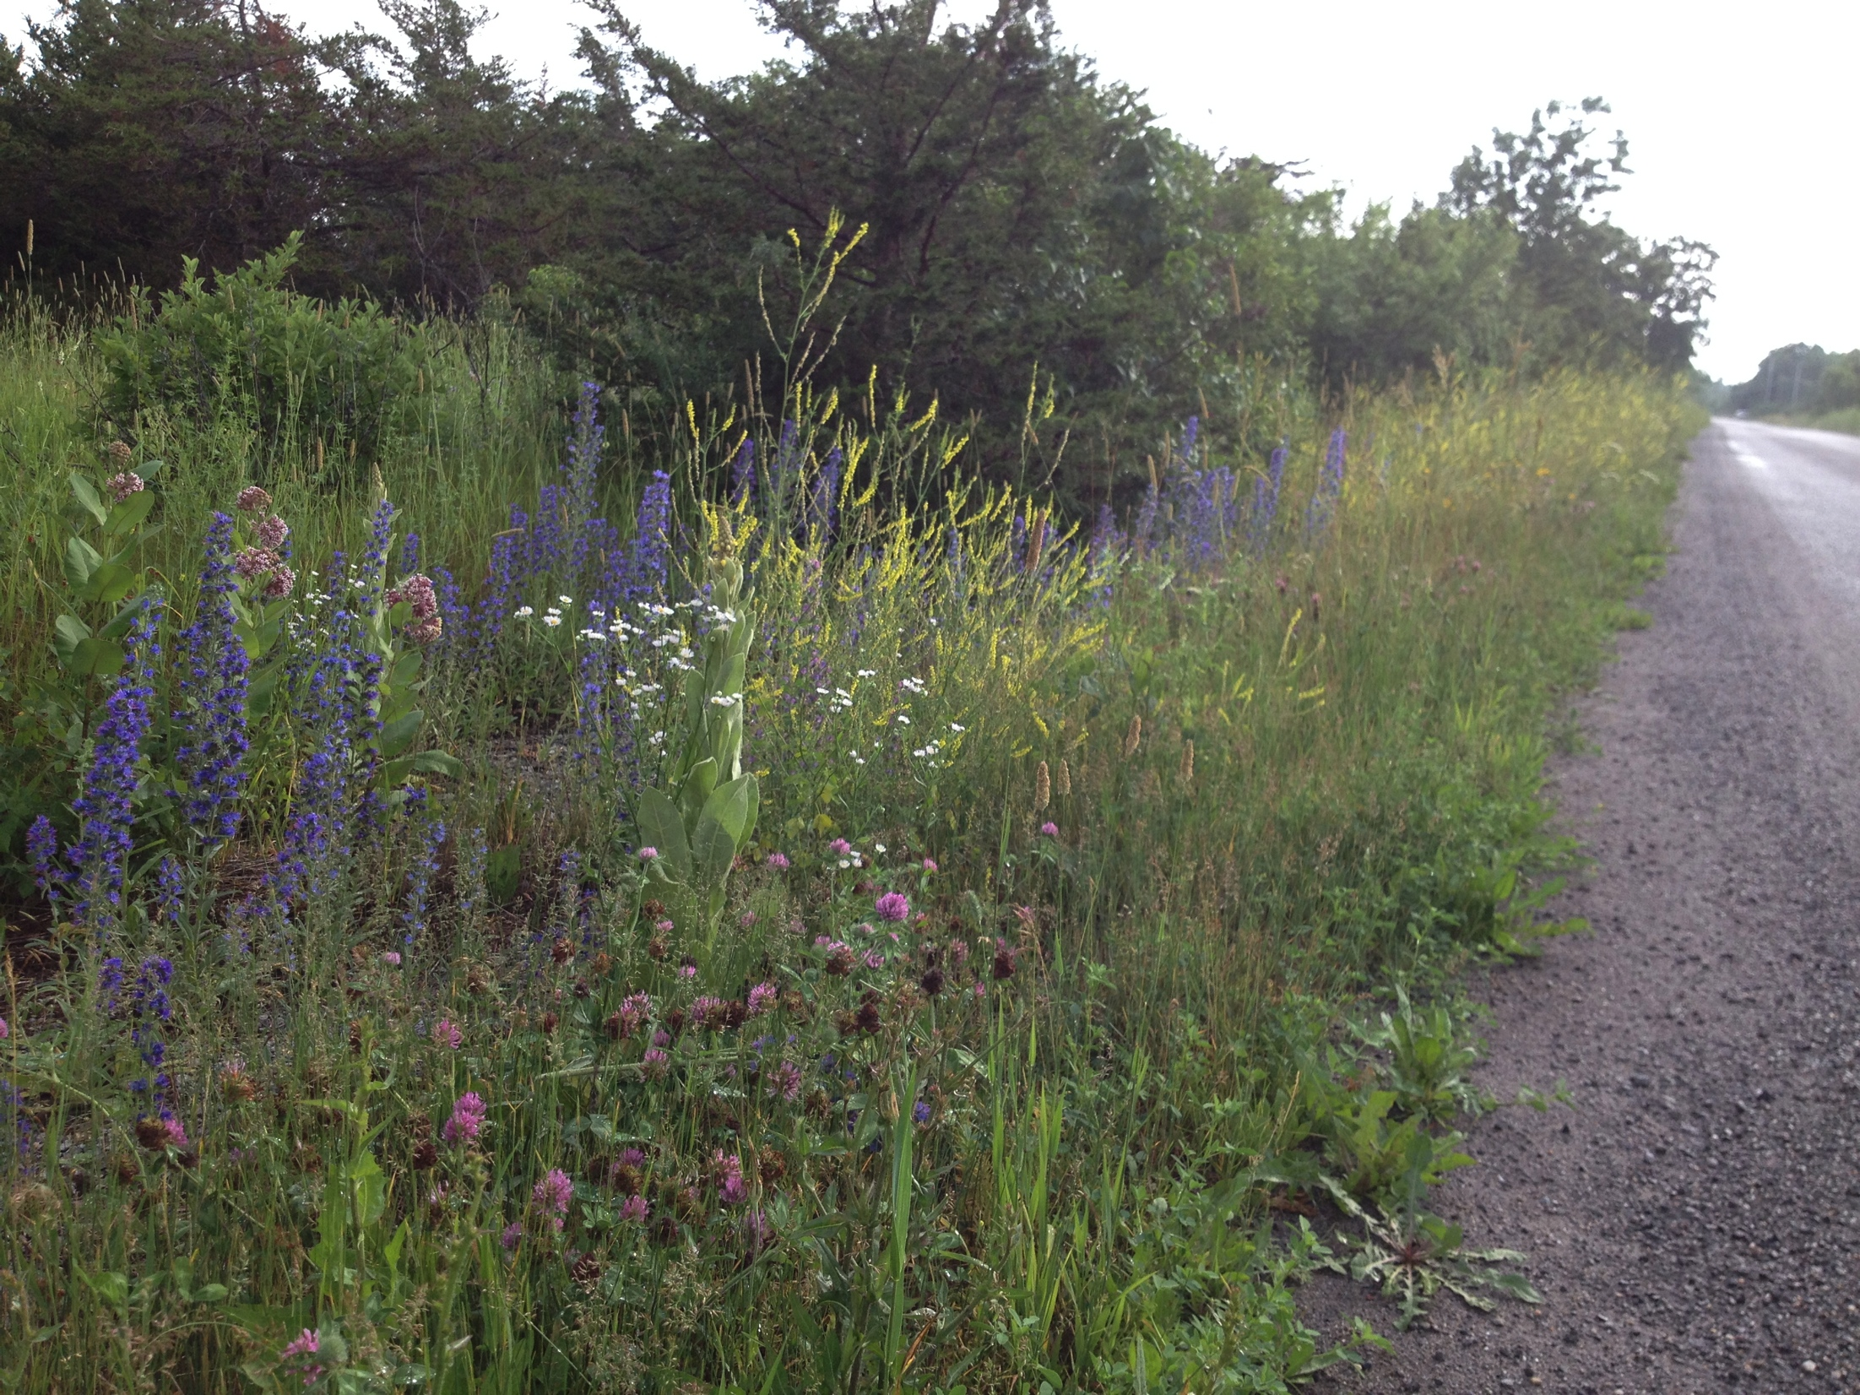
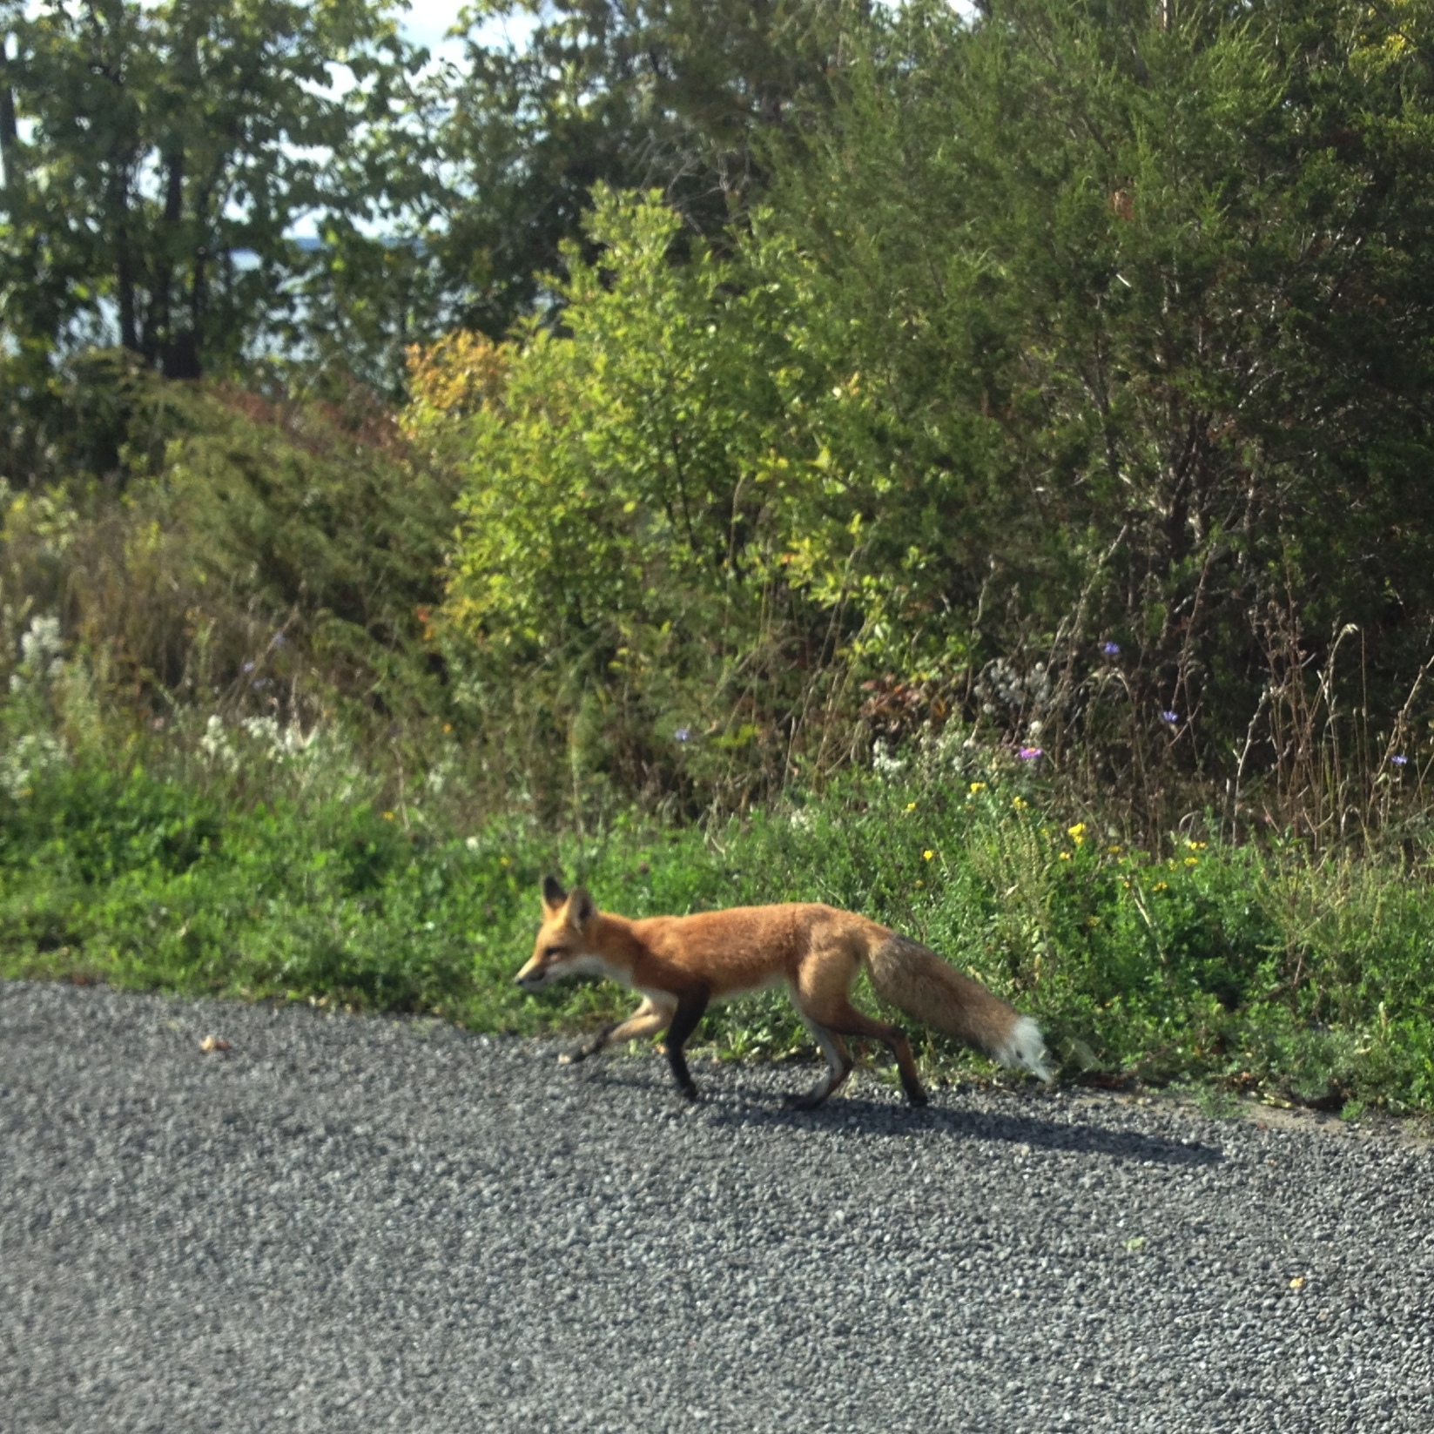
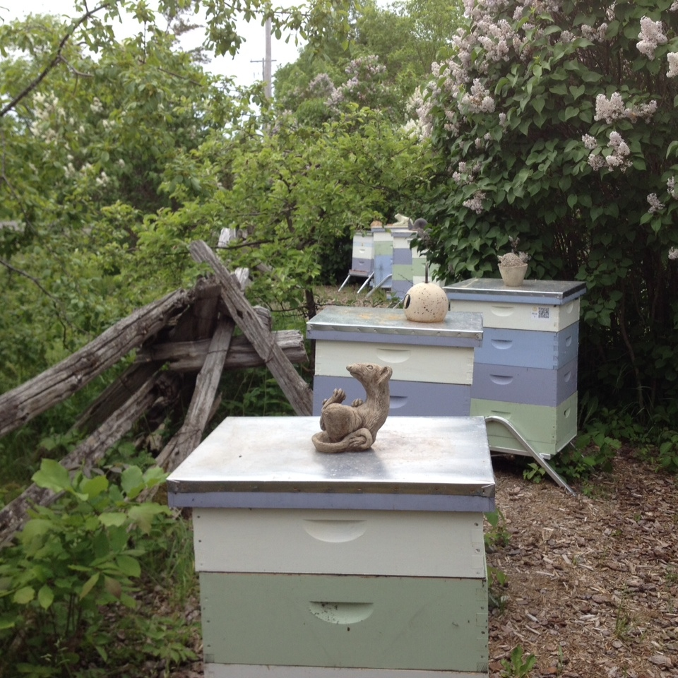
Record Keeping
Urban Toronto Beekeepers Association
April 4, 2017

Slide 2
Why keep records
Compliance
Accountability
Biosecurity
Productivity
Learning

Slide 3
Compliance
Cleaning log
Affidavits
Maps
Process

Slide 4
Accountability
Production
Colonies harvested
% moisture
# extracted
Tank
Sample saved
Numbered jars

Slide 5
Production
Cases produced
Sales records
Donations and gifts
Inventory

Slide 6
Biosecurity/learning
Queens/nucs purchased
Where, when
Hive inserted
Inspections

Slide 7
Searching for the best record system for inspections.
Personal inspection sheet
On-line system
Others I thought were interesting
Mike Palmer: duct tape
Brent Hawkins: push pins
But then,

Slide 8
“Let your bees tell you what they need.”
Tibor Szabo

Slide 9
‘Hearing’ the bees.
Use all senses
Over time rather than immediate
Systemic: -forage -beeyard-hive-bee

Slide 10
Forage area.
What’s in bloom
Weather
Water sources
...

Slide 11
Bee Yard: what’s going on?
Happy beeyard? Energy, activity level, defensiveness
Smell honey, floral fragrances
Flow?
How do the bees sound, other sounds?
Signs of pests or predators?

Slide 12
Hive - Outside.
Pollen, nectar coming in?
Level of activity/population
Signs of defecation.
Hygienic behaviour
Guard bees
Robbing, drifting?
Happy ‘playtime’?
Compared to last inspections, other hives?

Slide 13
Hive - internal.
Anything from last inspection/ outside inspection to monitor?
Sound. Queen, population, attitude
Smell: healthy? Odd?
Look: population. Up? Down?
Brood pattern
Brood

Slide 14
Hive - inside.
Pollen- diverse?
Propolis, comb
Queen cells, swarm cells?
Signs of disease/varroa
More or less drones?
Anything to monitor?
Any actions to take?

Slide 15
Records.
Small looseleaf notebook
Section for the beeyard
Section for hives, page or more for each hive
Note anything that seems noteworthy, but not the usual.
Mistakes
Any actions taken.
To do/monitor ** (whiteboard)

Slide 16
For a copy of these slides:
Longpointhoney.ca
Journal

